Slide 1
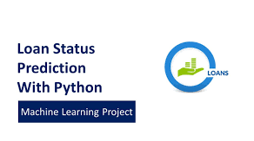
Finance and Risk Analytics
PGDSE ONLINE DEC-2020
Project title
LOAN STATUS PREDICTION
Mentor : Jatinder Bedi
Team members
Anjum Hassan
Basavaraj Bijali
Praveen
Dheeraj Gandikota
Titasta Bose

Slide 2
Problem Definition
Technology and business problem solution
When a customer approaches to the bank for a loan, The bank has to look into several factors to decide whether the person is eligible for loan or not. But the actual problem arises when these factors are not being analysed and loans that have been given to those customers are not being repaid due to several consequences.
First Let’s understand what is Financial Risk?
Banks and Financial sectors face various types of risks. When we combine them together we call it as FINANCIAL RISK. The risks can be classified as:
Credit Risk:
Default on loan
Liquidity Crisis
2. Market Risk:
Equity Risk
Interest Rate Risk
Currency Risk
Commodity Risk

Slide 3
Problem Definition
Business of bank:
The borrower might fail to pay back the loan which we usually call as Default of Loan.
Bank may fail to provide cash to the depositor on time which we call as Liquidity Crisis.
Possible solutions:
Grant credit to only those customers having a good Credit Score.
Understand the Loan History of a customer.
Loan insurance policy In case of unfortunate events such as job loss, accidental death or temporary disability loan insurance plans reduce a borrower’s outstanding loan amount and protect his or her monthly loan payments.
Risk based pricing for charging more interest rate to risky customers with less eligibility.

Slide 4
Previous models built on the same problem
There were other models built on the basis of this same problem. We observed certain problems with those models. Those models and their problems are as follows:
Approach 1:
(https://www.kaggle.com/danishkhan05/loan-status-prediction)
Variable Description
Loan ID -- Unique Loan ID
Gender -- Male/ Female
Married Applicant married -- (Y/N)
Dependents -- Number of dependents
Education Applicant Education -- (Graduate/ Under Graduate)
Self Employed -- (Y/N)
Applicant Income -- Applicant income
Co-applicant Income – Co-applicant income
Loan Amount -- Loan amount in thousands
Loan Amount Term -- Term of loan in months
Credit History -- credit history meets guidelines
Property_Area -- Urban/ Semi Urban/ Rural
Loan_Status -- Loan approved (Y/N)
Problems with this approach:
It had lack of features i.e. only 11 usable features were found. It also had only 615 records which is less data to be used for Machine learning.
Base models of Logistic Regression, Decision Tree and Random Forest were the only models built which is not the right way to do prediction.
After building the base models with no hyper parameter tuning, the maximum accuracy achieved was 86%

Slide 5
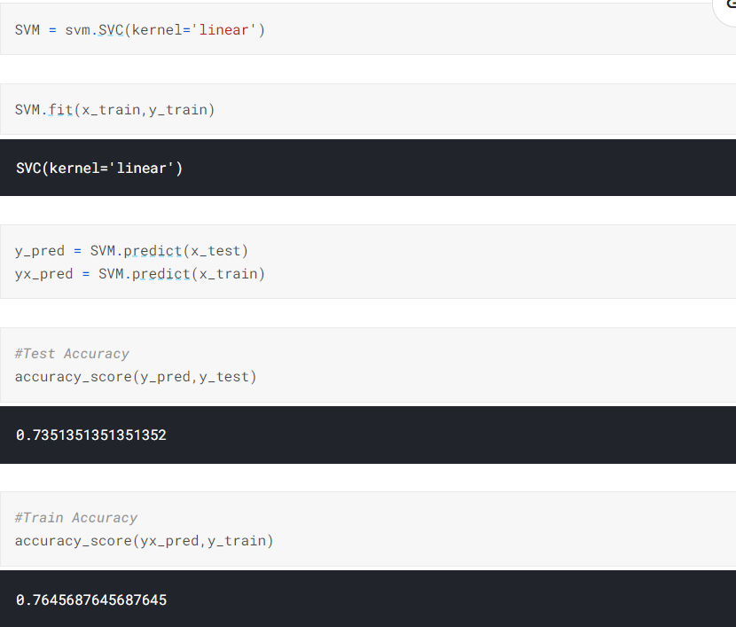
The model has performed average in the test set and it’s accuracy score is around 73%

Slide 6
Approach 2:
(https://www.kaggle.com/ajaymanwani/loan-approval-prediction)
Variable Description
Loan_ID -- Unique Loan ID
Gender -- Male/ Female
Married Applicant married -- (Y/N)
Dependents -- Number of dependents
Education Applicant Education -- (Graduate/ Under Graduate)
Self_Employed Self employed -- (Y/N)
ApplicantIncome -- Applicant income
CoapplicantIncome -- Coapplicant income
LoanAmount -- Loan amount in thousands
Loan_Amount_Term -- Term of loan in months
Credit_History -- credit history meets guidelines
Property_Area -- Urban/ Semi Urban/ Rural
Loan_Status -- Loan approved (Y/N)
Problems with this approach:
Another model made with same data using SVM classifier with linear kernel had test accuracy of only 81.25%.
No Hyper parameter tuning or cross validation was done with this model
Label encoder was used for categorical columns such as gender, married, self employed, property area but these are not ordinal data. They should have been encoded using one hot encoding
Likewise, no other model has been used to compare the accuracy of the model

Slide 7
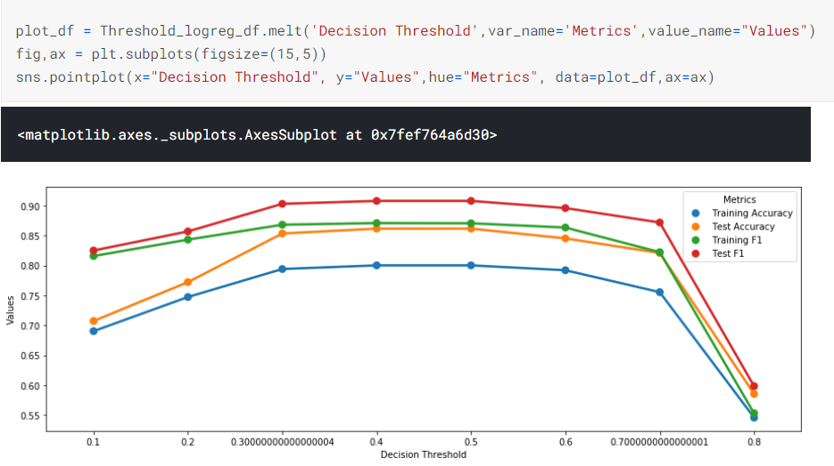

Slide 8
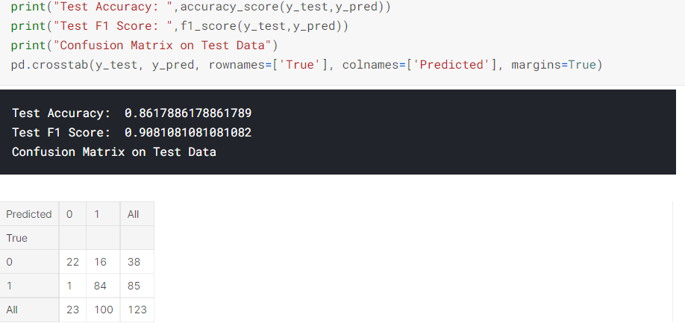
We can see that the accuracy score that this model has achieved at the end is around 86%

Slide 9
Approach 3:
ID
LIMIT_BAL
SEX
EDUCATION
MARRIAGE
AGE
PAY_0
PAY_2
PAY_3
PAY_4
PAY_5
PAY_6
BILL_AMT1
BILL_AMT2
BILL_AMT3
BILL_AMT4
BILL_AMT5
BILL_AMT6
PAY_AMT1
PAY_AMT2
PAY_AMT3
PAY_AMT4
PAY_AMT5
PAY_AMT6
default.payment.next.month
Problems with this approach :
This dataset had around 30000 records and 23 features which can be considered to be suitable to work with.
The features like Bill Amount, Pay are not interpretable and no documentation has been provided for these features
Target feature name suggests if the payment is done for the next month only not as a whole
There is a lack of scope of predicting if the loan amount is completely paid or charged off from this data.
Due to these pain points ,we cannot proceed with this dataset.

Slide 10
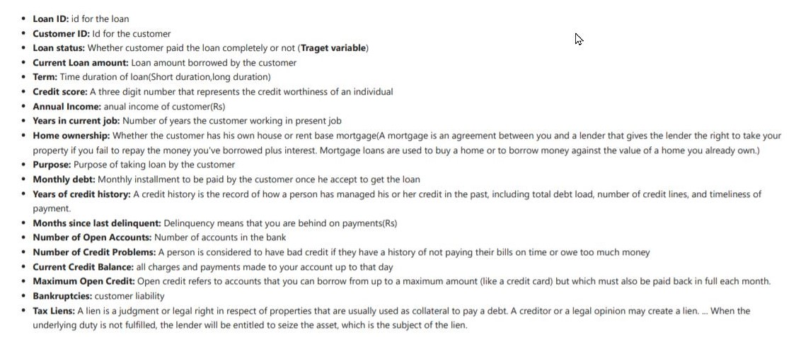
Solution:
By understanding the relationship between the underlying factors that significantly affect a person’s credit score and therefore impacts the customer’s loan eligibility. An improved model that uses these significant features in order to predict the loan status and credit score which acts as a decision making tool. The problem offers to solve the hassle of loan process in regards to the borrower (customer) and lender (bank).
Data Sets:
Bank Loan Status Dataset | Kaggle

Slide 11

Challenges:
All numerical features are Right Skewed
Current loan amount have some Outliers
Credit score: after 1000 all values in credit score shows loan status as charged off (which is strange we need to deal with it).
Credit score has maximum value 7510 which is not correct (Because credit score is three digit number).

Slide 12
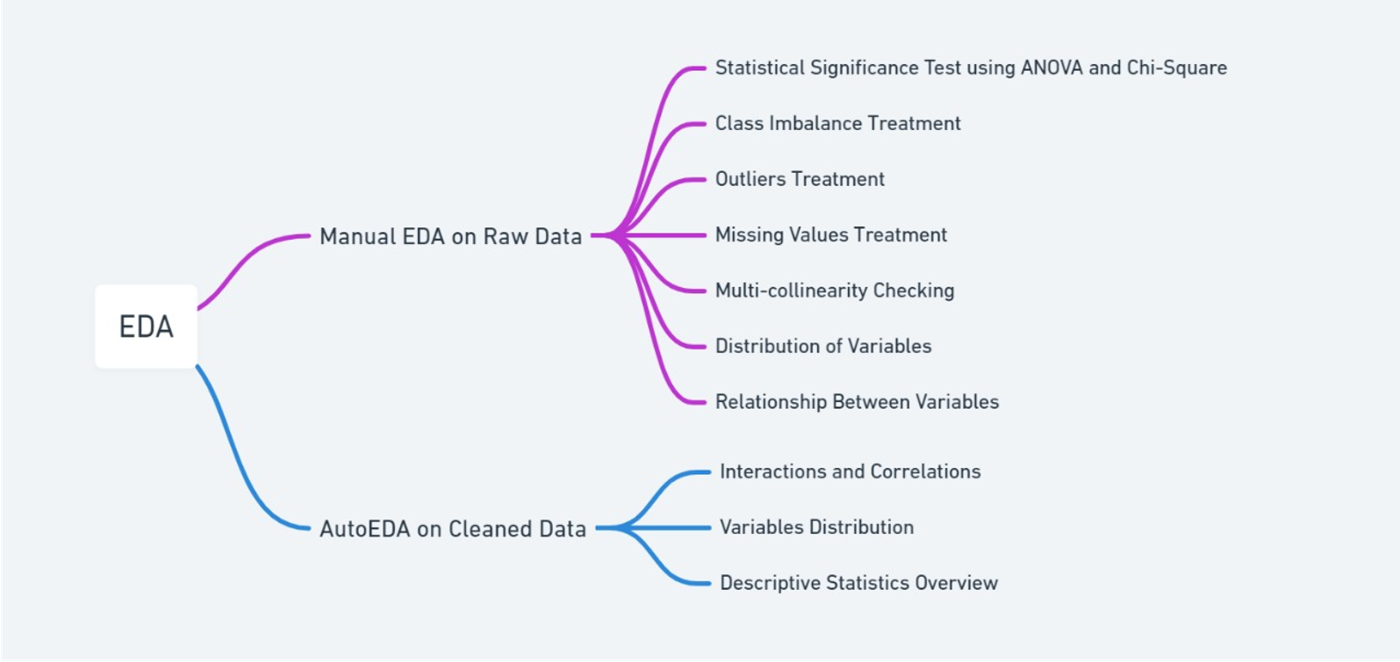
EDA Approach

Slide 13
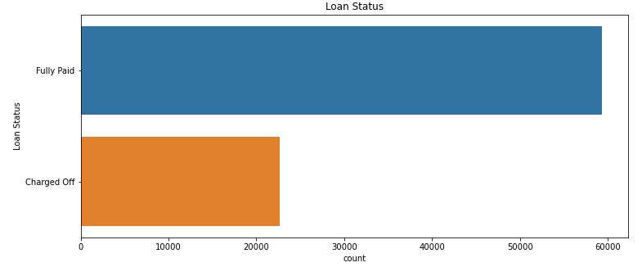
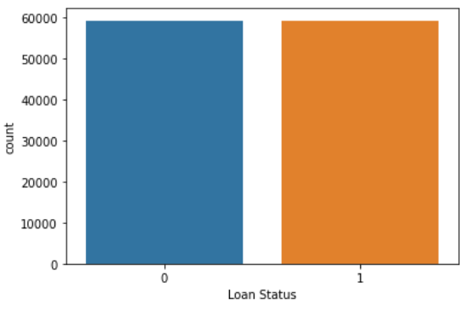
Class Imbalance Treatment
SMOTE

Slide 14
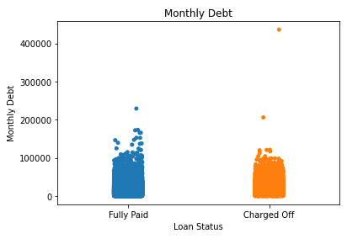
Outlier Treatment

Slide 15
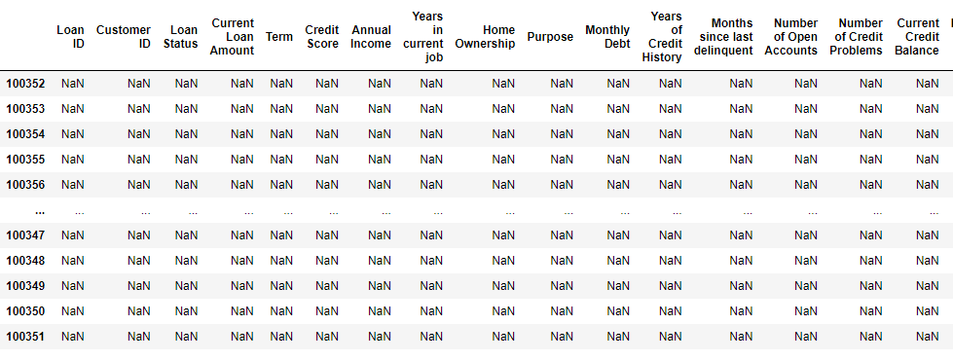
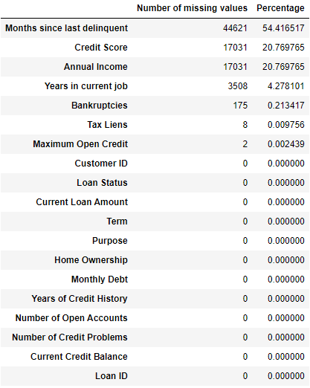
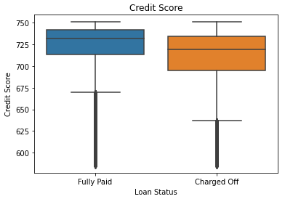
Missing Value Treatment
Complete null rows
Missing value counts and percentage

Slide 16
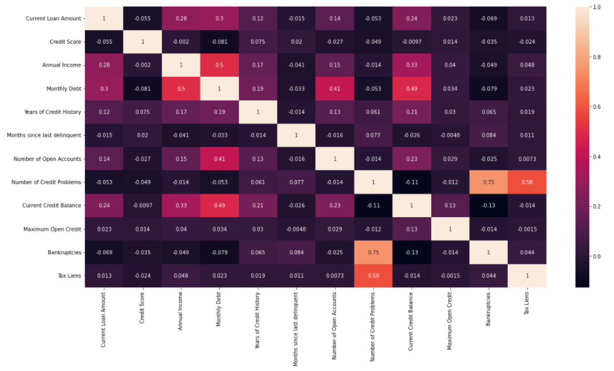
Correlation For Numerical Features

Slide 17
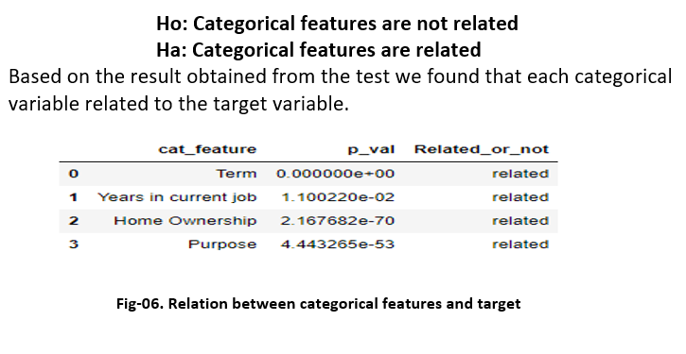
Relationship Between Categorical and Numerical Features

Slide 18
AutoEDA
Python external library (Dataprep) used in order to understand the cleaned data. The result’s given below
DataPrep Report
Overview
Variables
Interactions
Correlations
Missing Values
Overview

Slide 19
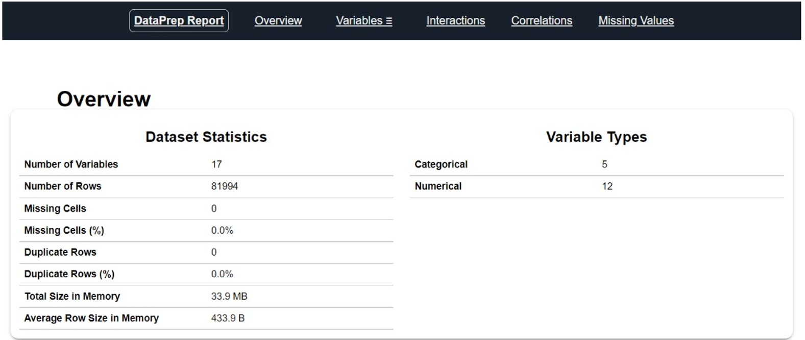
AutoEDA

Slide 20
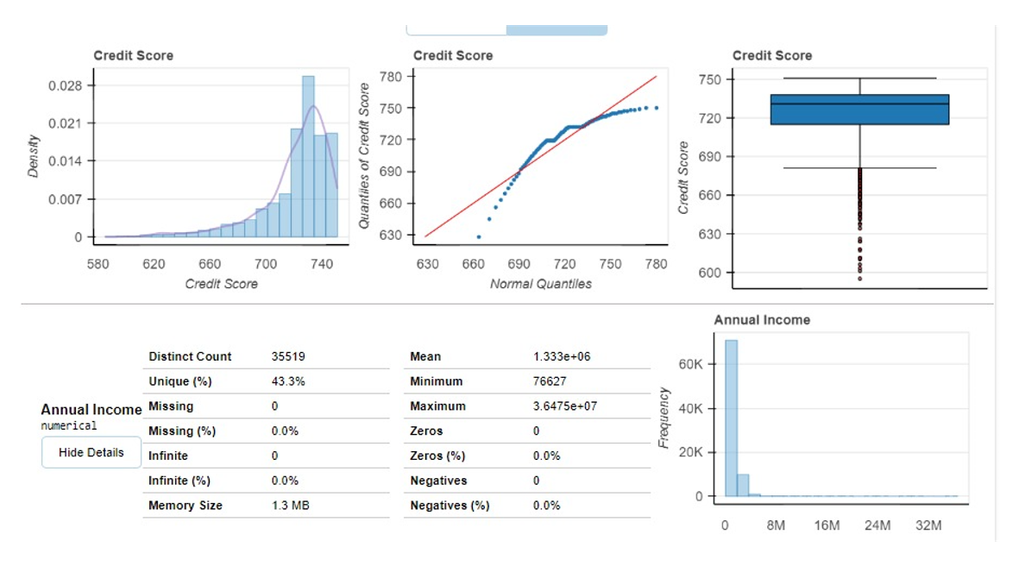
AutoEDA

Slide 21
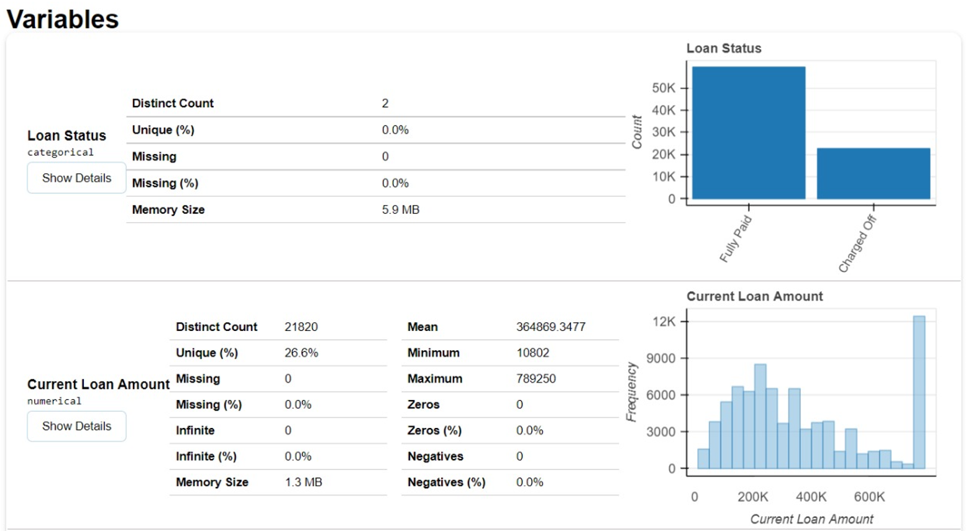
AutoEDA

Slide 22
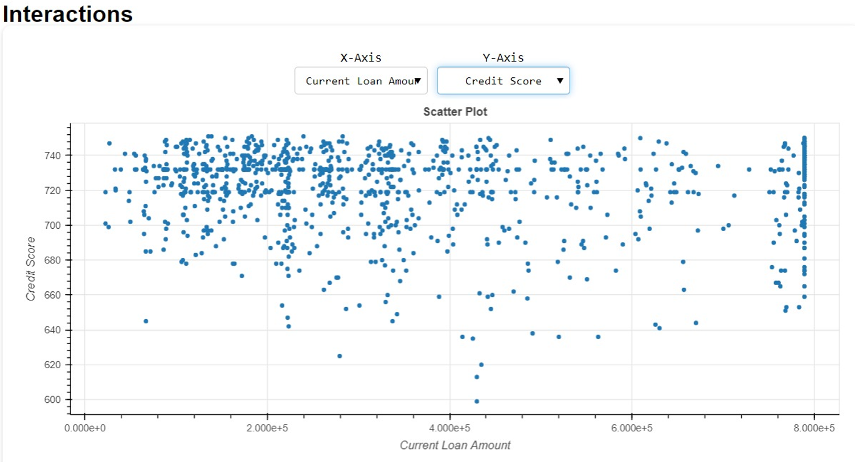
AutoEDA

Slide 23
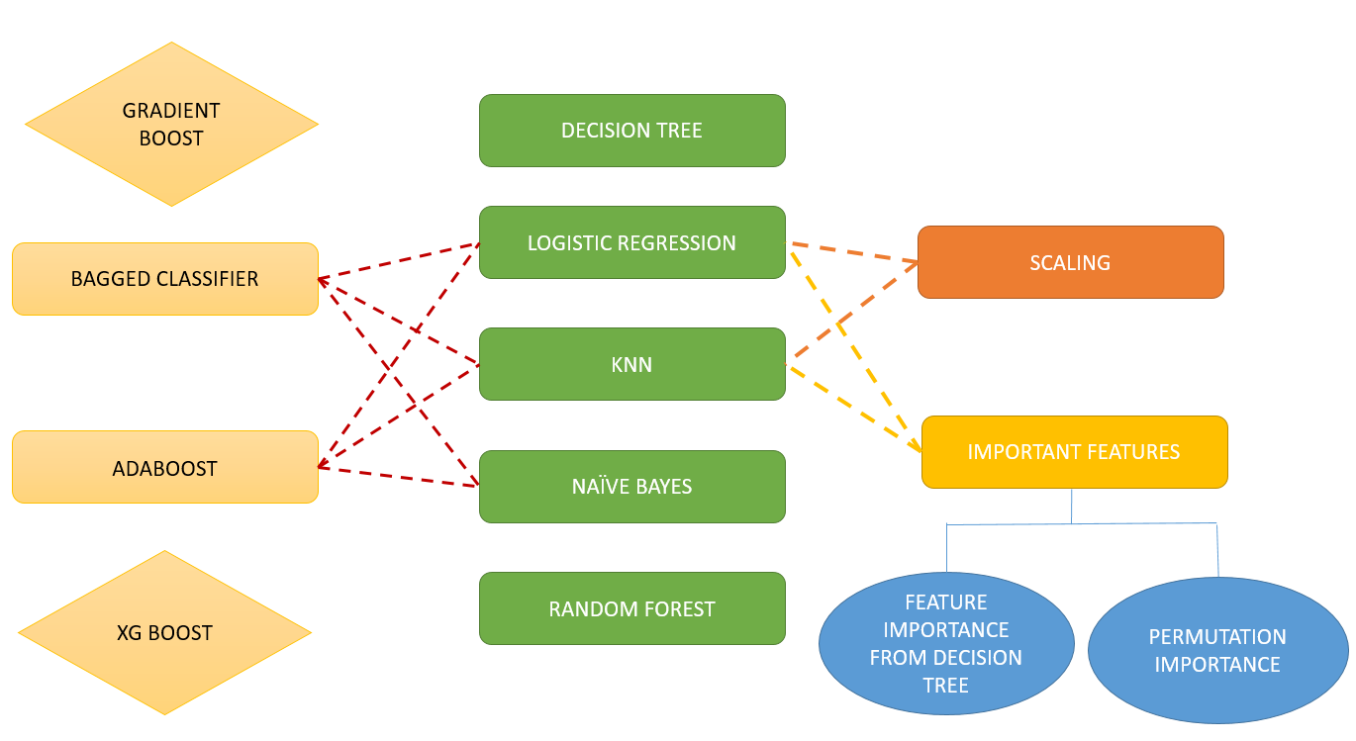
Algorithms, Solution and Conclusions:

Slide 24
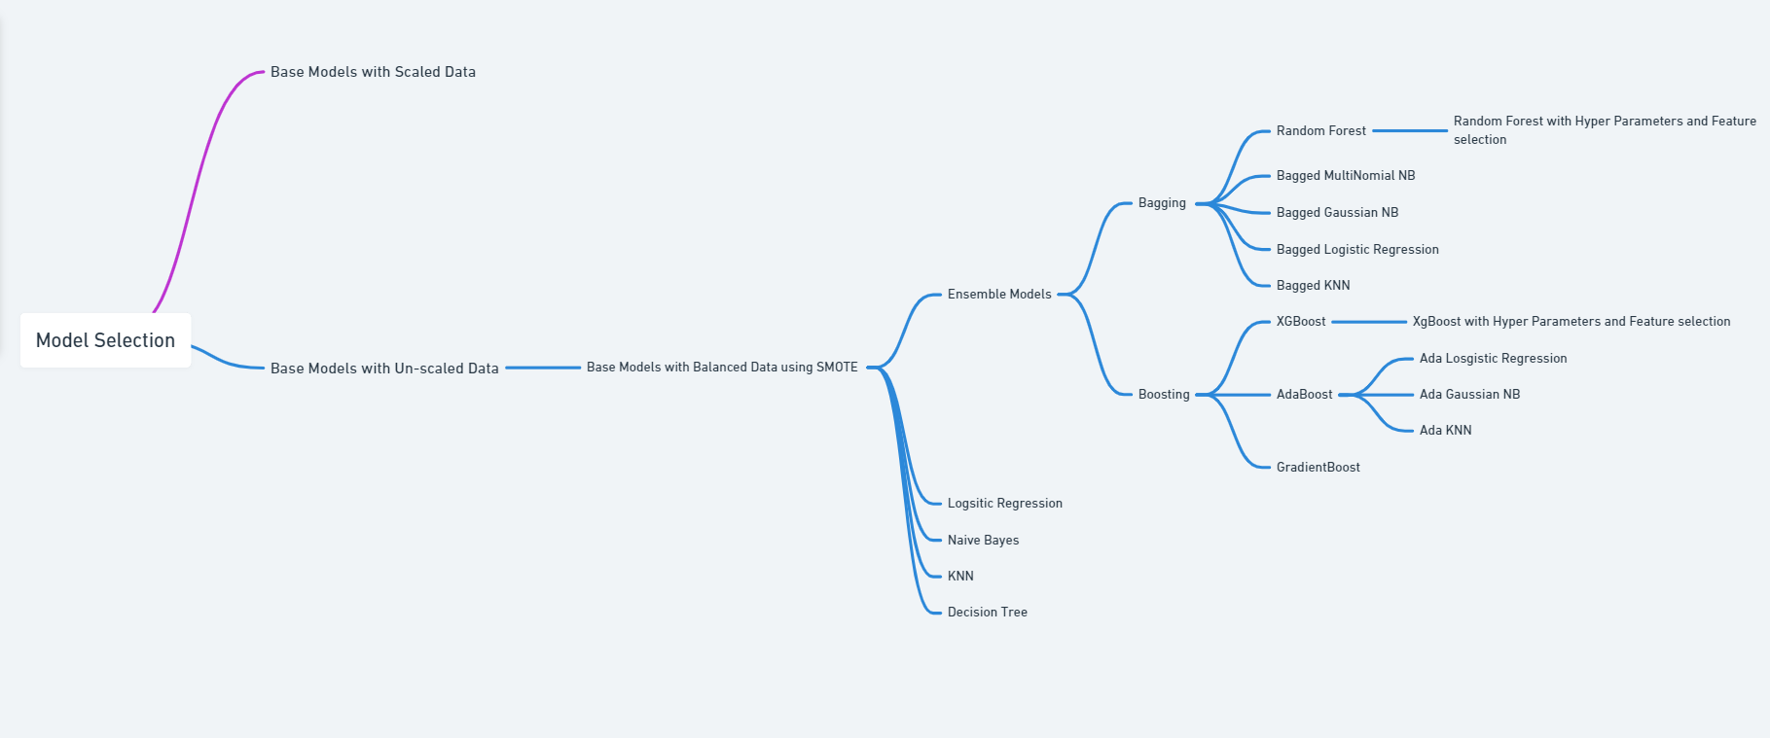
Modelling Approach

Slide 25
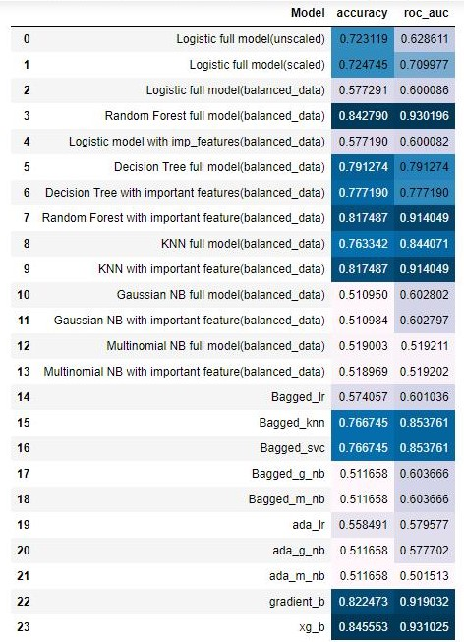
Algorithms, Solution and Conclusions:
Algorithms considered with pros and cons :
24 Different classification based ML models including:
Base models.(with all numerical and categorical features)
Models based on Feature Selection.(Feature importance and Permutation Importance)
Models based on Scaled and Unscaled data.(Standard Scaling)
Basic Classification models : Logistic Regression, Decision Tree, Naïve Bayes , KNN.
Ensemble models (Bagging and Boosting models) : Random Forest, Bagging Classifier with different estimators, Boosting Classifiers namely AdaBoost, Gradient Boost Classifier and XGBoost.

Slide 26
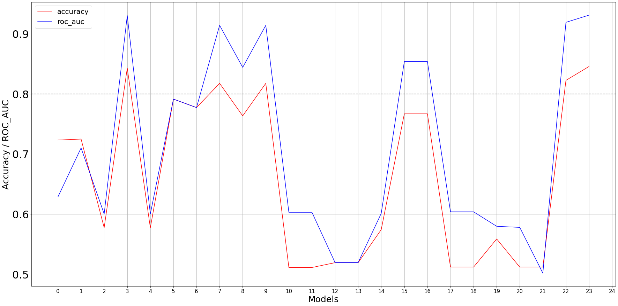
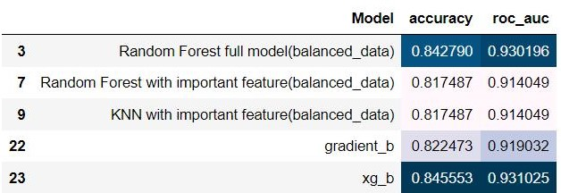
Algorithms, Solution and Conclusions:
Solution architecture (technical and functional):
At least 80% cut-off considered for both accuracy and ROC_AUC metrics.
XgBoost and Random Forest (both with balanced data and all features) these are top performers.
Improvement scope: Hyper Parameter Tuning.

Slide 27
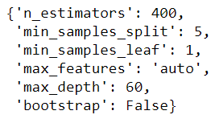
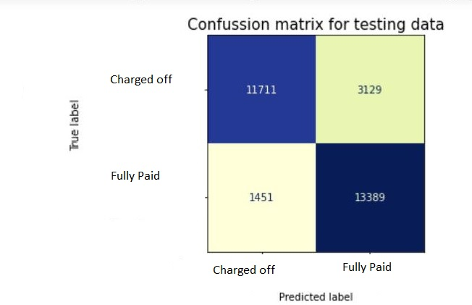
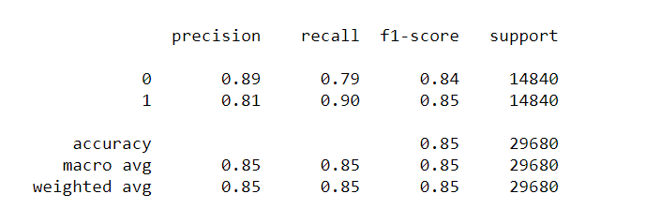
Algorithms, Solution and Conclusions:
Results:
Based on our observation , we found that Random Forest with all features , balanced data and hyper parameters is performing the best in terms of both ‘Accuracy_score’ and ‘ROC_AUC’ (85% and 93% respectively).
Hyperparameters used:

Slide 28
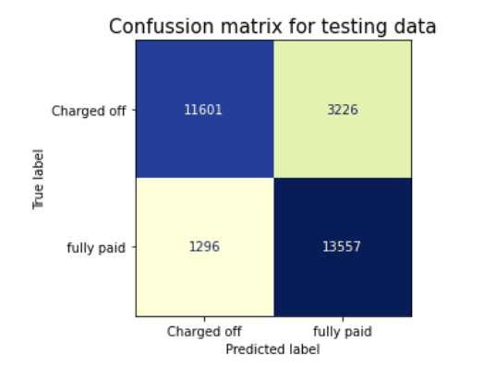
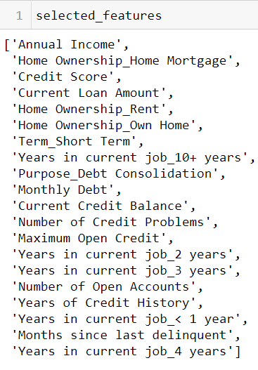
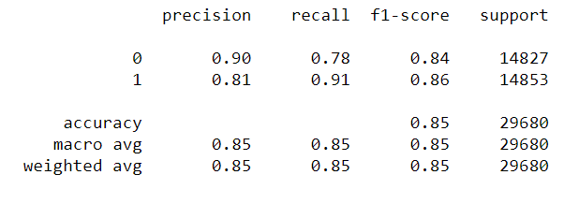
Results:
Based on our observation , we found that XgBoost with selective features , balanced data is performing the best in terms of ‘Accuracy_score’ (85%).
It is better than Random Forest as it only utilizes 50% of total number of features to provide similar test accuracy.

Slide 29
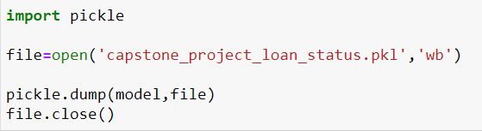
Model Export using Pickle
We have finalized XgBoost with balanced data and with selective features as our preferred model for deployment.
Export model : Pickle

Slide 30
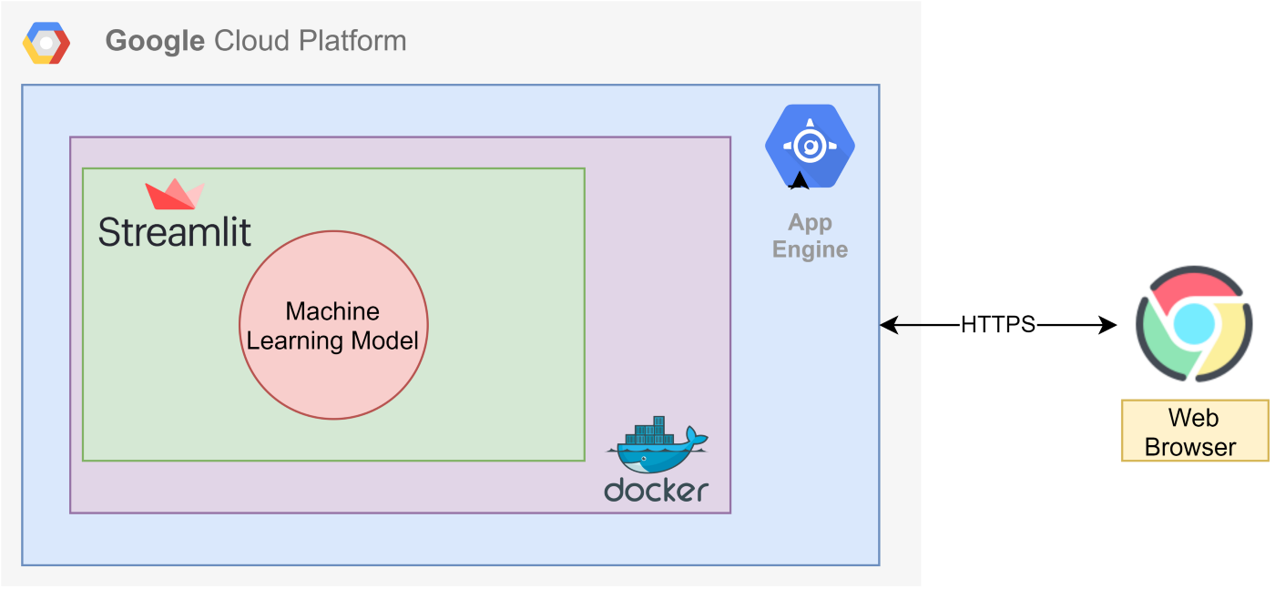
How to take to production:
Available Options :
Flask/Heroku
AWS Sagemaker
Streamlit/Google Cloud Platform
Model Deployment Architecture for Streamlit /Google Cloyd Platform based deployment approach:
Additional Tools Used:
VSCode
Google SDK

Slide 31
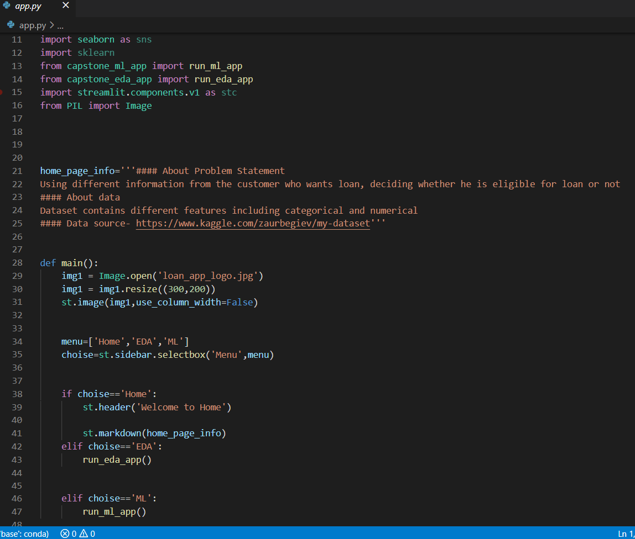
Web UI Files Code Snippet and configurations for local and cloud deployment
File-name: app.py

Slide 32
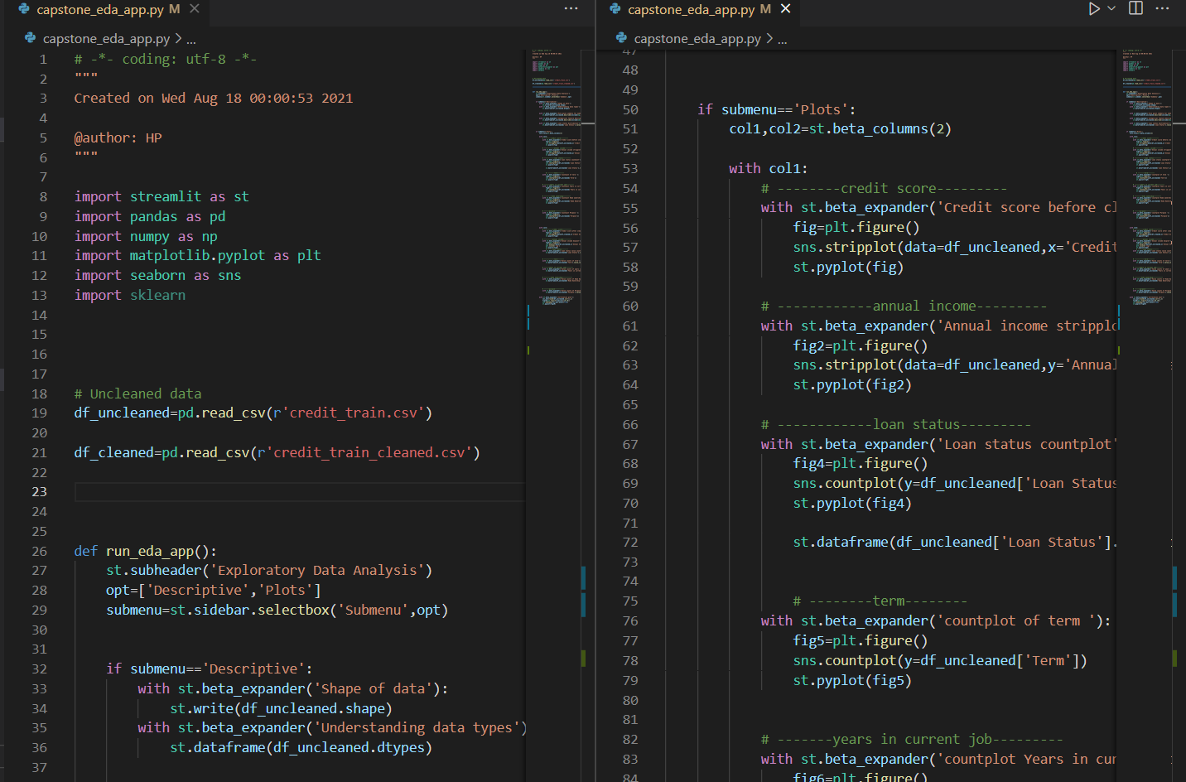
Web UI Files Code Snippet and configurations for local and cloud deployment
File-name: capstone_eda_app.py

Slide 33
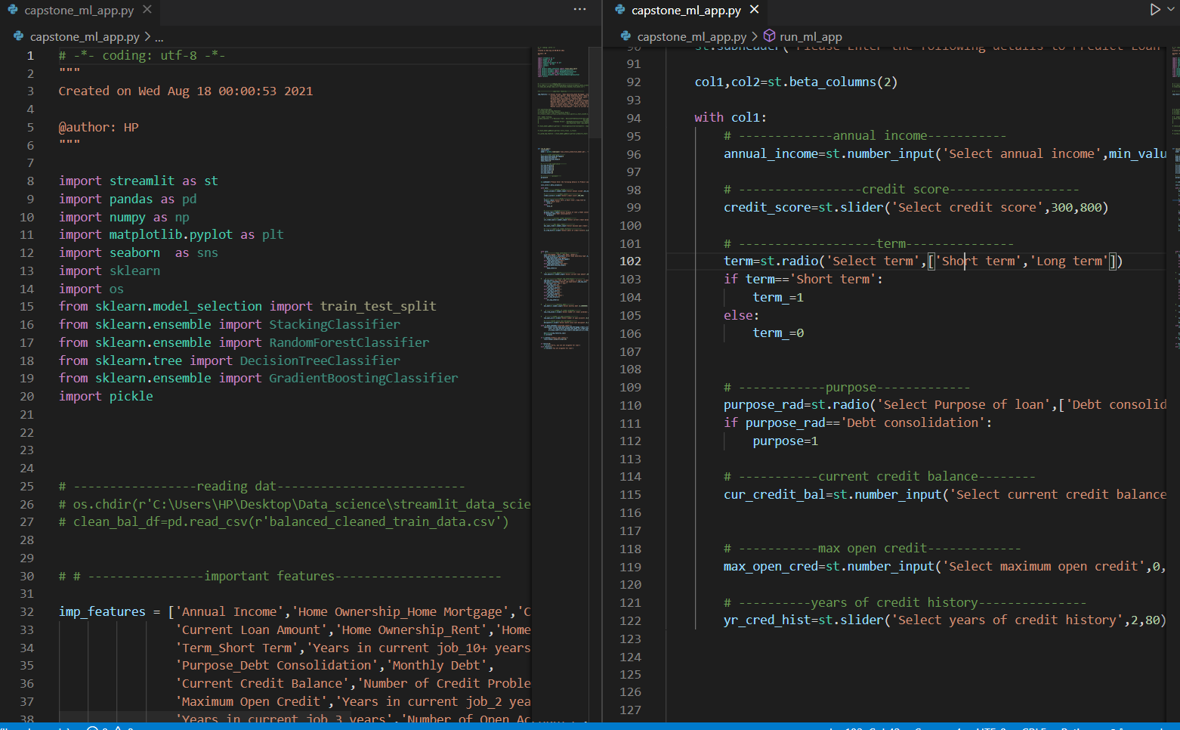
Web UI Files Code Snippet and configurations for local and cloud deployment
File-name: capstone_ml_app.py

Slide 34
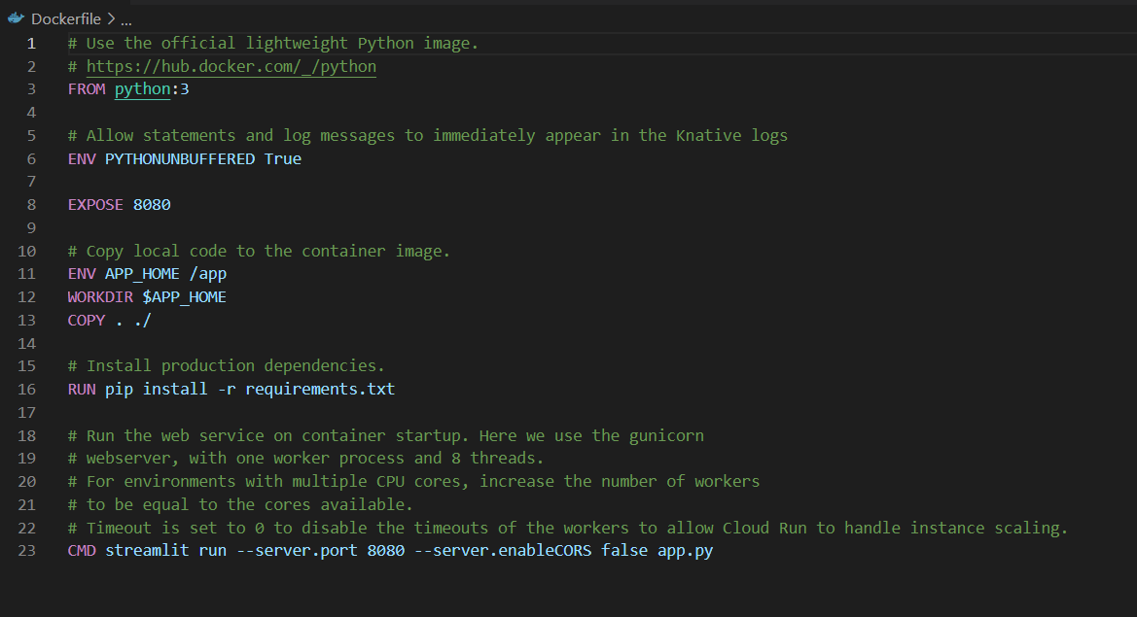
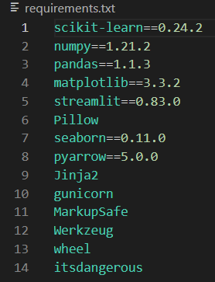
Web UI Files Code Snippet and configurations for local and cloud deployment
File-name: Dockerfile and requirements.txt

Slide 35
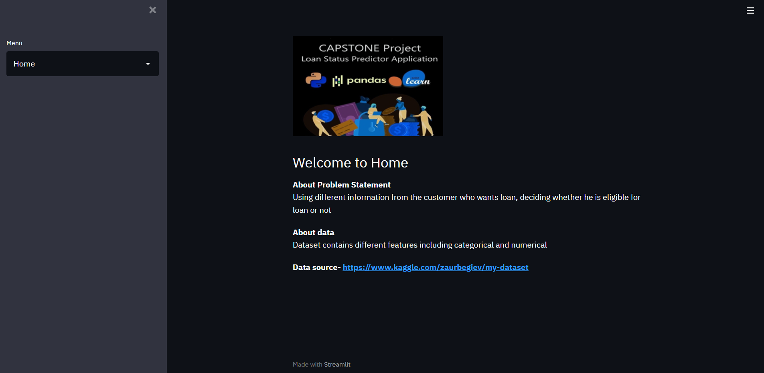
Deployed Application Web UI Hosted in Google Cloud Platform
Link : https://loan-status-prediction-326315.el.r.appspot.com/
Application Homepage

Slide 36
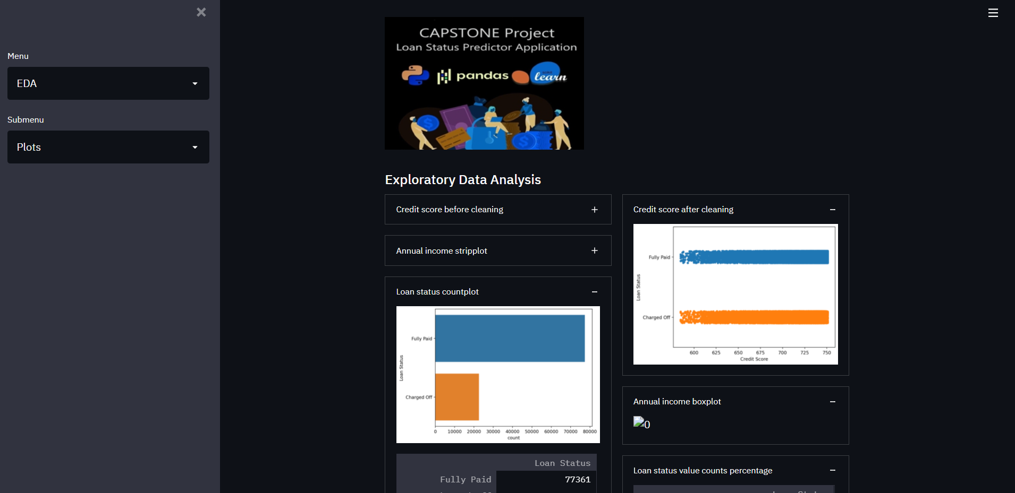
Deployed Application Web UI Hosted in Google Cloud Platform
Application EDA Page

Slide 37
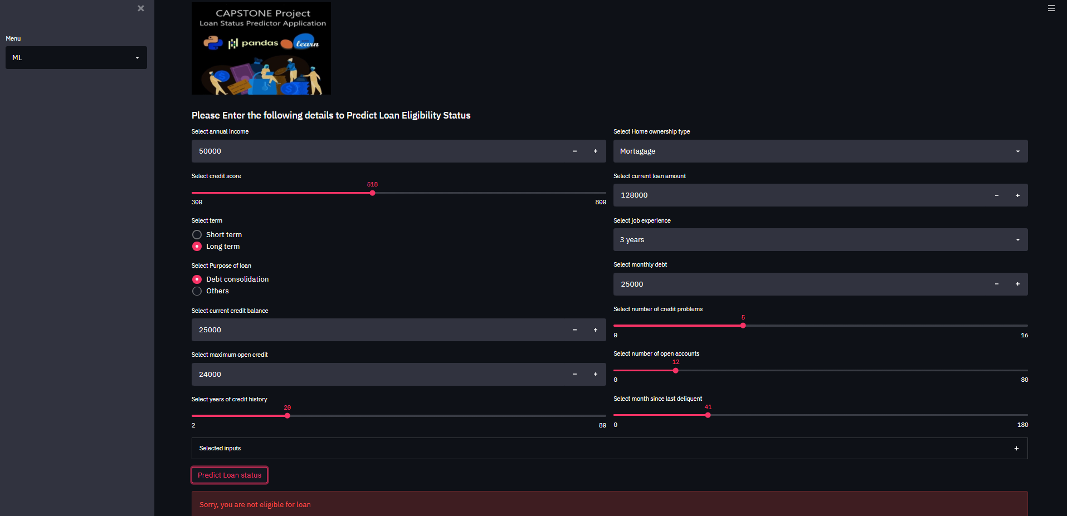
Deployed Application Web UI Hosted in Google Cloud Platform
Application ML Page

Slide 38

Algorithms, Solution and Conclusions:
Limitations, Future Scope and Conclusion:
Artificial data injection due to SMOTE oversampling. (Biased data).
Might perform poor in production due to unseen data.
Extensive pre-processing is done before modelling. So, in real time, test-data needs to pass through data pre-processing filter before invoking prediction algorithm.
Scope of prediction is limited to specific features used for modelling.

Slide 39
Thanks!
Q/A and feedback

